Slide 1

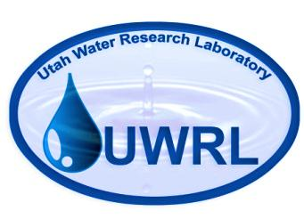

Data Model and High Performance Computing Tools to Advance Water Resources Management and Modeling
Adel M. Abdallah and David E. Rosenberg
Team #2 meeting Feb 6, 2014

Slide 2
Motivation
“How can we best structure data and computer models to address scientiﬁc problems through the use of high-performance and data-intensive computing by discipline scientists coming to this problem without extensive computational knowledge and algorithmic experience?”
Contribution: Water Management Data Model (WaM-DaM)

Slide 3
WaM-DaM in a Workflow

Slide 4
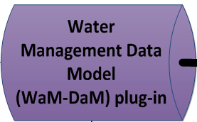
Research Contribution #1
A Relational Model for Water Resources Management Data (WaM-DaM)
Achievement so far
Decided on WaM-DaM features (structure, metadata, etc.)
Drafted UML design for WaM-DaM and re-engineered
several models (WEAP, HydroPlatform, and ResSim)
Steps ahead
Document WaM-DaM design specifications plus controlled vocabularies
Finalize the logical model and implement the physical relational model of WaM-DaM
Demonstrate the capabilities of WaM-DaM and data analysis that can be done

Slide 5
Heterogeneous syntactic and semantic data

Slide 6
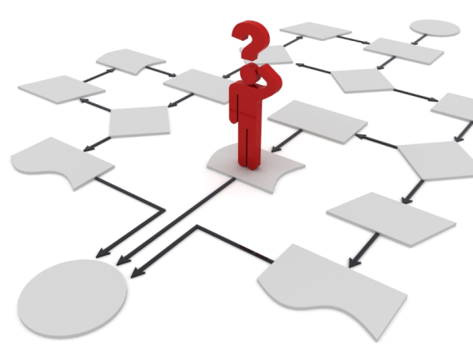
Research Contribution #2
A New Integrated Method to Discover, Transform, and Deliver Data to Water Management and Hydrologic Models
Achievement so far
Developed a conceptual schematic of the
automated procedure
Steps ahead
Identify the components of the automated procedure
Map out a model’s native vocabulary to the WaM-DaM controlled vocabulary
Write up the stored procedures to search, transform, and deliver data for GoldSim and WEAP models
Start
End

Slide 7

WaM-DaM to GoldSim
Give me all the available data that are needed to set up a GoldSim water management model for Parleys Canyon Watershed?

Slide 8
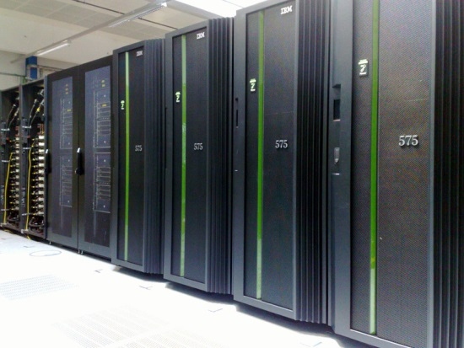

Research Contributions #3
High Performance Computing to Enhance Water Resources Management and Modeling
Achievement so far
Installed the General Algebraic Modeling System (GAMS) at Mount Moran cluster
Steps ahead
Implement parallel computing in GAMS for an example optimization model (Water and Energy Conservation Model)
Use HydroGate to interact with Mount Moran

Slide 9
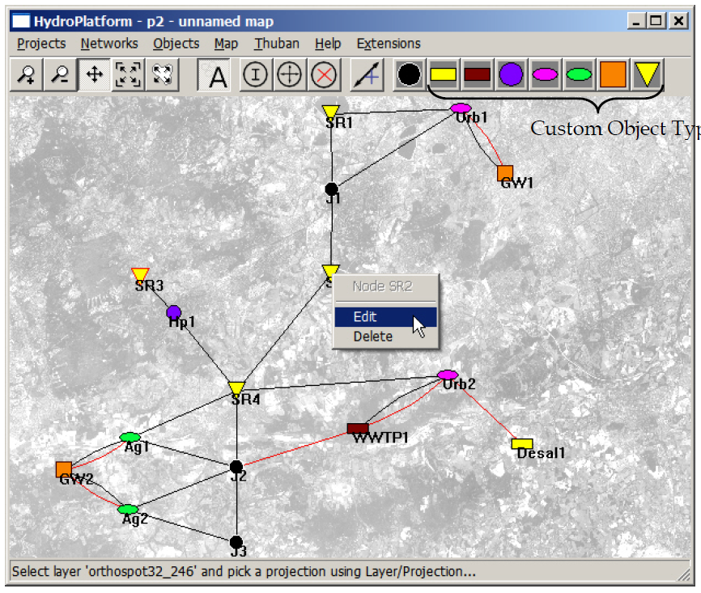
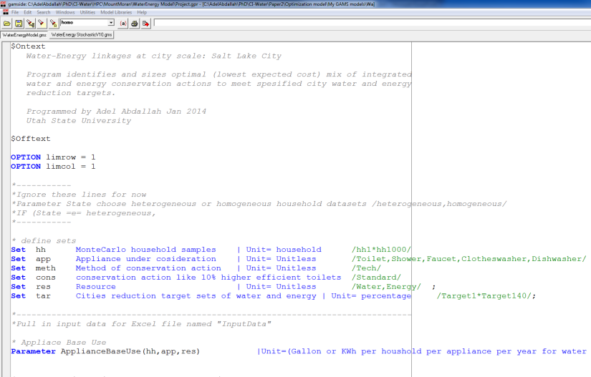
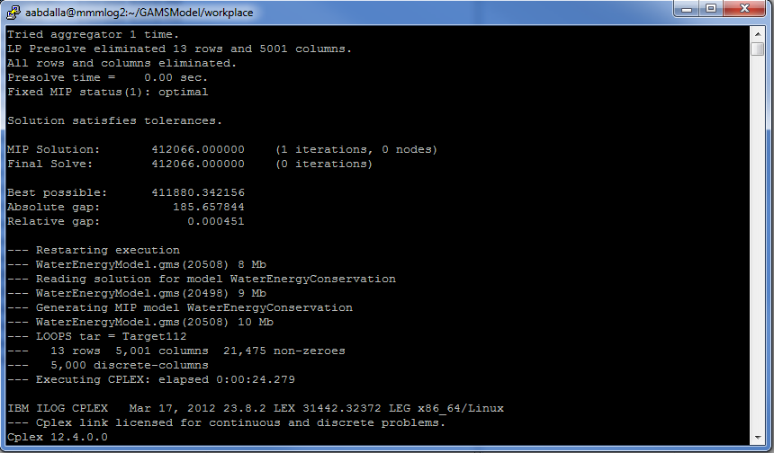
WaM-DaM-Hydra to GAMS to HPC

Slide 10

Deliverables
Completed
WaM-DaM: A Universal Standard to Communicate Water Systems Data
Upcoming
WaM-DaM: AWRA Spring Specialty Conference". Snowbird. May 12-14, 2014
Water and Energy Conservation Model EWRI, ASCE. Portland, Oregon. June 1-5, 2014
WaM-DaM: iEMSs. San Diego. June 15-19, 2014 . Meet with the Hydra developers

Slide 11
Thanks!
Questions?

Slide 12
WaM-DaM Core Concepts
Discover existing water management data
Introduce standards of controlled vocabularies to publish, share data and allow models interoperability
Implement a relational data storage format to help access, query and move data across models.
Support metadata documentation like sources, collections methods, units, and sites.
Build networks from customizable objects of nodes and links.

